Slide 1
CSE 602 - Wireless Network And Mobile Computing
Sigfox
P22CS013
Nihar Sodhaparmar

Slide 2
Contents
Sigfox History
Network Architecture
Technology Principles
Key Features of Network
Security and Privacy
Applications

Slide 3
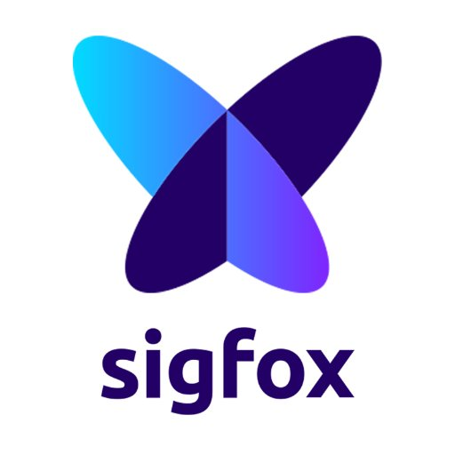
Sigfox
Sigfox wireless technology is based on LTN (Low Throughput Network).
It is wide area network based technology which supports low data rate communication over larger distances.
It is used for M2M and IoT applications which transmits only few bytes per day.
It is pioneer in LPWAN technologies for large scale development.
LPWAN is also known as Low Power Wide Area Network. It is a wireless wide area network which varies from 2 km to 1000 km range.

Slide 4
Sigfox (continue...)
This technology remotely interfaces battery operated devices and sensors to the internet.
Sigfox offers an end to end network which sends small data packets from sensors through the network and cloud to connect the sensors to the digital world.
Sigfox provides the network, the technology and the expert ecosystem, which are necessary to help companies and organizations make the most of their IoT ambitions.
Sigfox uses less power and is effective over long distances compared to connection protocols such as Bluetooth and Wi-Fi which works best in the short range and use more power.

Slide 5
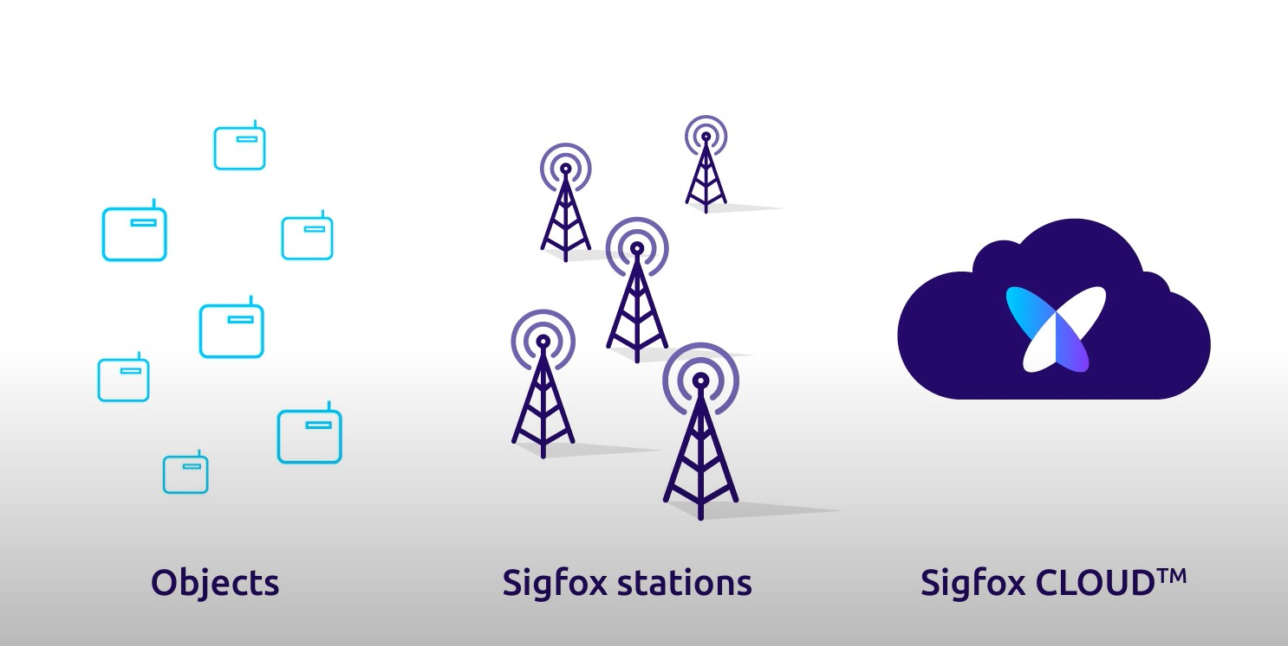
Network Architecture
It consists of three important elements
Objects
Base Station
Sigfox Cloud

Slide 6
Network Architecture (continue...)
Objects
Objects are also generally called devices which include sensors these objects send their data to a base station.
Base Station
Base stations are local Sigfox antennas that receive messages from emitting devices and forwards them to the Sigfox cloud.
Sigfox cloud
Sigfox cloud is a central hub where all the information is stored and data processing takes place.

Slide 7
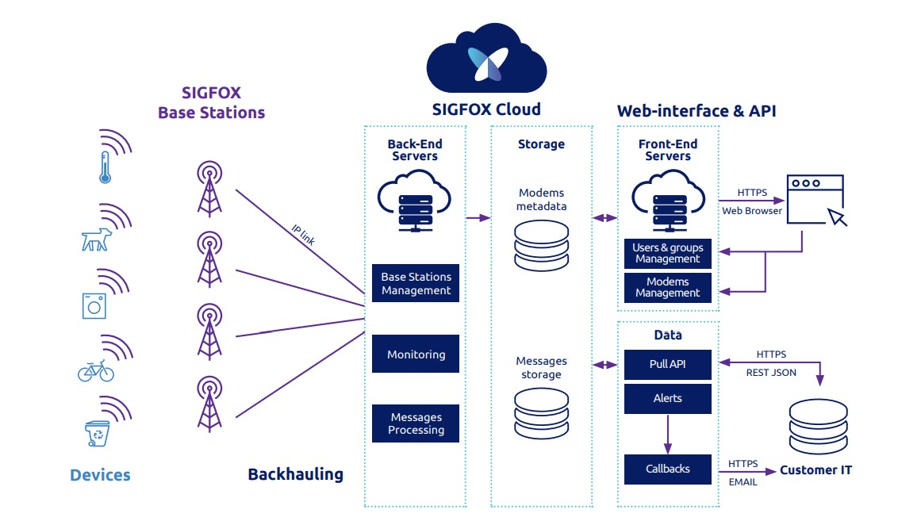
Flat network architecture

Slide 8
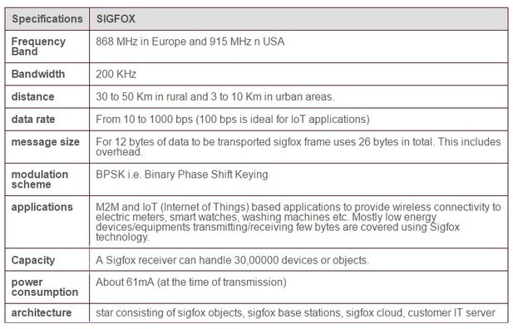
Sigfox Specifications

Slide 9
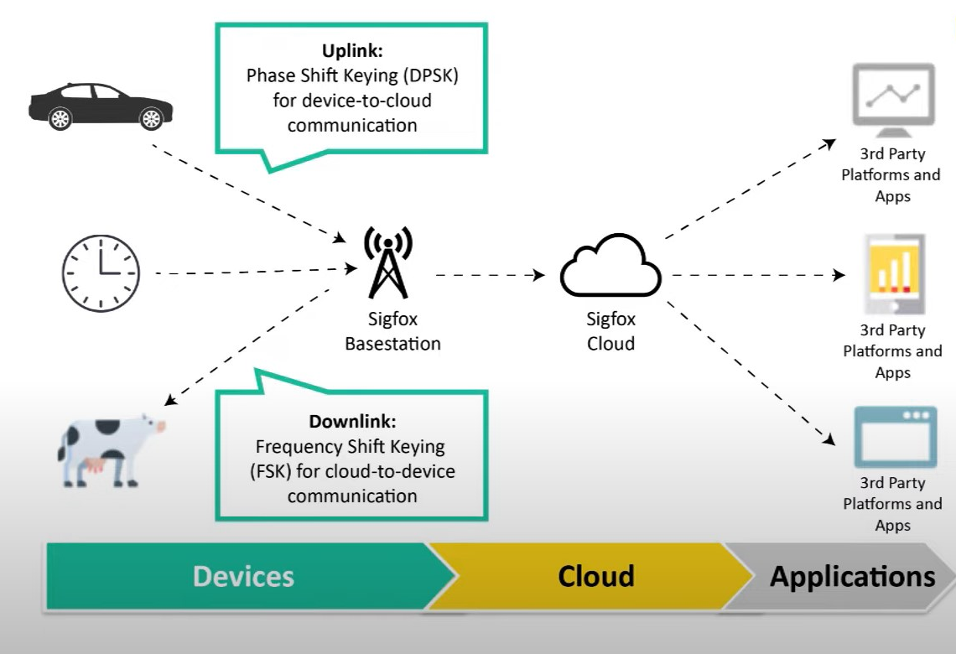
Sigfox uses Differential Phase Shifting Keying (DPSK) for uplink and Frequency Shift Keying (FSK) for Downlink.
Uplink signals generally encounter more interference compared to downlink signals. DPSK is bandwidth efficient compared to FSK and more robustness to the interference.
Interference is not much concern for downlink signal the main goal is to reach as many applications as efficiently as possible.
FSK offers more bandwidth thereby giving more space send to a signal to reach more applications.

Slide 10
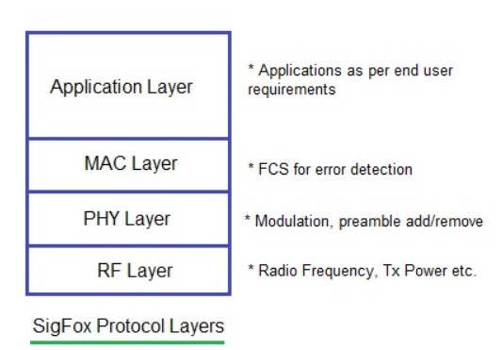
Sigfox Protocol Stack

Slide 11
RF Layer
This layer takes care of frequency assignment and transmit/receive power requirements at Sigfox end points and base stations
There are two implementations of the radio layer in Sigfox system viz. UNB (Ultra Narrow Band) and OSSS (Orthogonal Sequence Spread Spectrum).
PHY Layer
It handles MAC frame during transmission and during reception.
UNB implementation is carried out for uplink transmission of messages. The downlink transmission of messages can be implemented.
MAC Layer
Application Layer

Slide 12
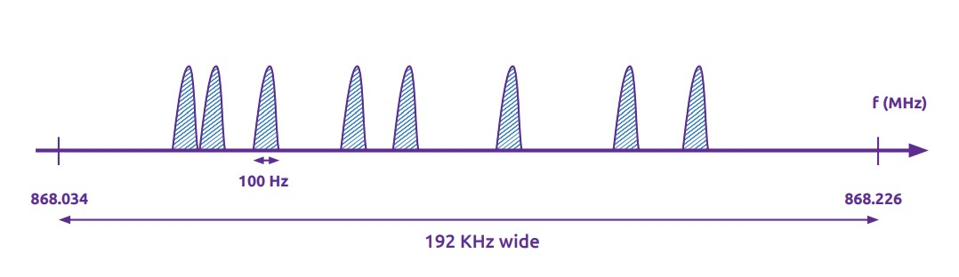
Sigfox Technology Principles
Ultra Narrow Band (UNB)
Sigfox is using 192KHz of the publicly available band to exchange messages over the air.
The modulation is Ultra-Narrow band. Each message is 100 Hz wide and transferred with a data rate of 100 or 600 bits per second depending on the region.
This is what enables the Sigfox base stations to communicate over long distances without being impacted by the noise.

Slide 13
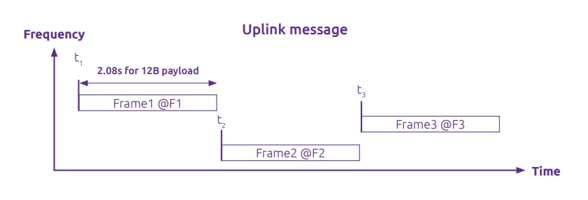
Sigfox Technology Principles (continue...)
Random Access
The random access is a key feature to achieve a high quality of service.
The transmission is unsynchronized between the network and the device.
The device emits a message on a random frequency and then sends 2 replicas on different frequencies and time, which is called “time and frequency diversity”.

Slide 14
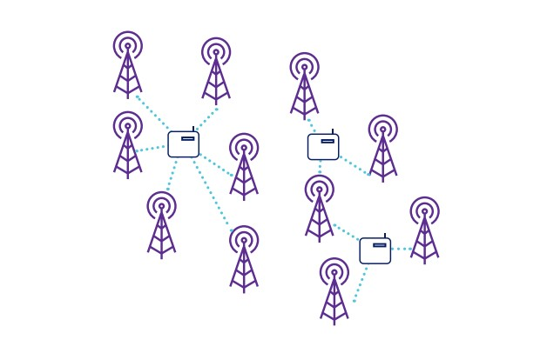
Sigfox Technology Principles (continue...)
Cooperative Reception
The principle of the cooperative reception is that an object is not attached to a specific base station unlike cellular protocols.
The emitted message is received by any base stations that are nearby and on average the number of base stations is 3. This is called “spatial diversity”.

Slide 15
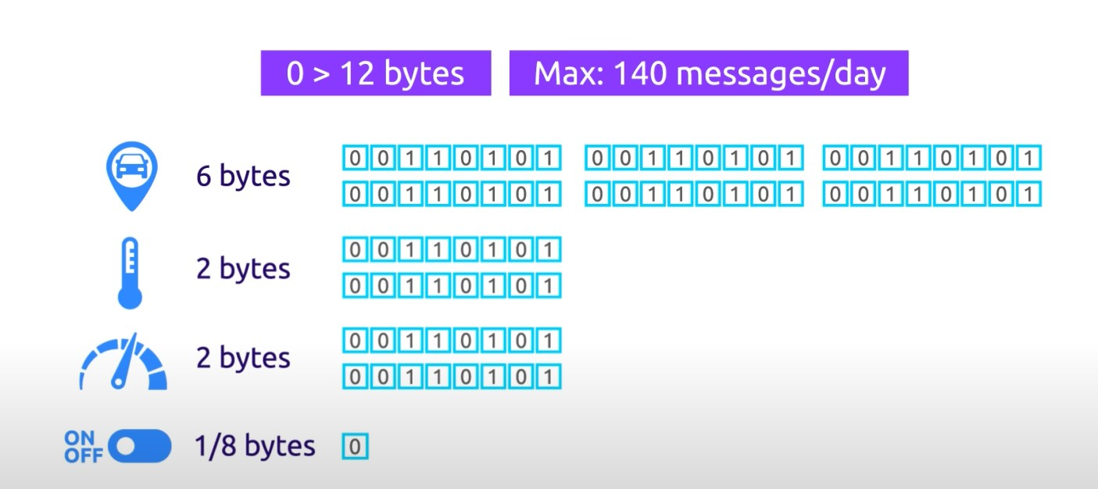
Sigfox Technology Principles (continue...)
Small Messages
In order to address the cost and autonomy constraints of remote objects, Sigfox has designed a communication protocol for small messages.
The message size goes from 0 to 12 bytes. A 12-byte payload is enough to transfer sensor data, the status of an event like an alert, GPS coordinates or even application data.

Slide 16
Key Features of Network
High network capacity
High energy efficiency
Long range
Resilience to interferers

Slide 17
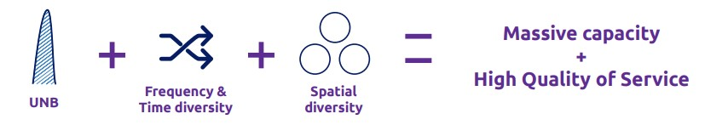
High Network Capacity
Ultra-narrow band modulation has the benefit of being spectrum efficient and resistant to interferers as all of the energy is concentrated into a very small bandwidth.
Frequency and time diversity introduced by the random access.
Spatial diversity due to the overlapping network cells.

Slide 18
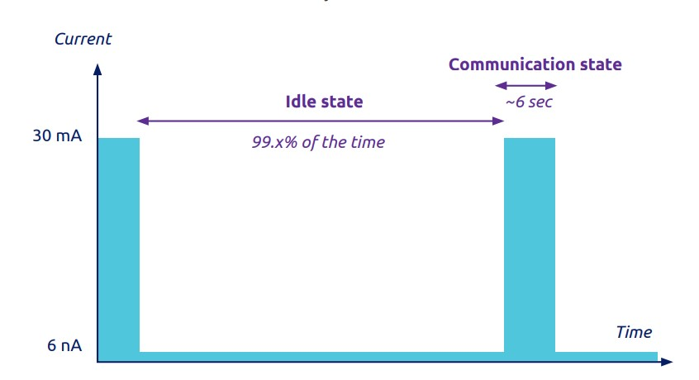
High energy efficiency
No pairing is required, which means that no synchronization messages are exchanged between the object and the base station before transmitting the data. This is a big advantage compared to other technologies which all include those additional steps.
Also the idle consumption is very low, often a few nanoamperes, which makes it almost negligible.

Slide 19
Long Range
The main competitive advantage of the Sigfox technology is on the deployment with a large coverage and a limited number of base stations.
For a given output power, the range of the radio frequency (RF) link is determined by the data rate, i.e. a lower rate provides a longer range.
Implementation of long range base stations enables implementation of a wide range Sigfox network at minimal costs.

Slide 20
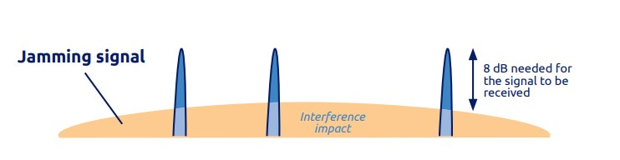
Resilience to interference
Sigfox utilizes 192KHz Ultra Narrow Band (UNB) integrated with the base station’s spatial diversity of +20 dB which facilitate its unique anti-jamming features.
The low noise overlap induces intrinsic ruggedness to the Ultra-Narrow band. As a result, for a message to be transmitted, the signal should have at least 8 dB.

Slide 21
Sigfox Security and Privacy
Firewall Security
Sigfox has an inbuilt firewall that restricts IoT objects to connect or communicate using the internet protocol.
To communicate over the internet, an object sends a radio message that is picked up by the available access stations.
The access station then relays the message to the Sigfox support system that in turn transmits it to the specified destination.
The Sigfox support system also transmits the response to the sender object through the base stations.
The security firewall thus secures the IoT objects from internet related attacks.

Slide 22
Sigfox Security and Privacy (continue...)
Data Security
The Sigfox architecture provides a security mechanism that guarantees secure data authentication and replay avoidance.
The Sigfox’s IoT chain involves authentication keys stored which are stored by devices and the customer, this key will be required to access the data stored by the Sigfox System.
Sigfox’s data mechanisms guarantees security within the diverse ecosystem and different local regulations.
The authentication key for every device is unique meaning that a compromise of a device’s authentication security key does not affect the security of other devices.

Slide 23
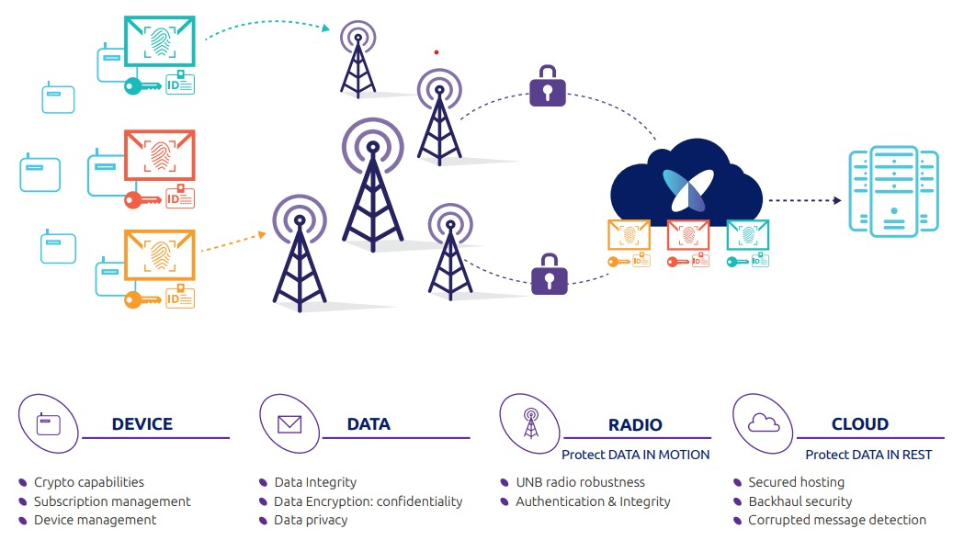
Sigfox Security and Privacy (continue...)

Slide 24
Applications of Sigfox
People, Goods or other type of Asset tracking
Smart metering communication in the energy sector
Communication of mHealth applications
Remote control and monitoring
Smart parking
Waste management
Security

Slide 25
References
https://www.sigfox.com/technology/
https://build.sigfox.com/sigfox#network-overview
https://www.rfwireless-world.com/Tutorials/Sigfox-tutorial.html
https://www.avnet.com/wps/wcm/connect/onesite/03aebfe2-98f7-4c28-be5f-90638c898009/sigfox-technical-overview.pdf?MOD=AJPERES&CVID=magVa.N&CVID=magVa.N&CVID=magVa.N#:~:text=Sigfox%20is%20using%20192KHz%20of,second%20depending%20on%20the%20region.
https://circuitdigest.com/article/what-is-sigfox-basics-architecture-and-security-features#:~:text=Application%20of%20Sigfox&text=People%2C%20Goods%20or%20other%20type,communication%20in%20the%20transport%20sector
https://www.youtube.com/watch?v=jcYoNvkorOY&t=5s

Slide 26
Thank you

